Slide 1
Metadata + Naming Things
JoJo
06-02-2023

Slide 2

What is metadata?
Why should we care so much about metadata?
Isn’t it just “data about data”?
Shouldn’t we be focused on the data?
Slide adapted from The DDI Training Working Group, “Introduction to Metadata for Research Data management: The DDI Perspective,” presented on April 29, 2021

Slide 3
What is metadata?
If You Care about Data, You Care about Metadata!
Metadata is what allows people to discover, assess, and navigate through collections of data
Metadata is what allows people to understand data
Metadata is what allows machines to process and manage data
Metadata is what allows people to harmonize, integrate, and reuse data
If you want FAIR data, you need metadata!
Slide courtesy of The DDI Training Working Group, “Introduction to Metadata for Research Data management: The DDI Perspective,” presented on April 29, 2021

Slide 4
What is metadata?
Metadata is the Limiting Factor
Your data is only as good as the metadata which describes it
Traditionally, research has focused on data supporting specific research
Now, the demand for larger, cross-cutting research projects places an emphasis on better data management
The answer to providing this is to have good, well-managed metadata!
Slide adapted from The DDI Training Working Group, “Introduction to Metadata for Research Data management: The DDI Perspective,” presented on April 29, 2021

Slide 5
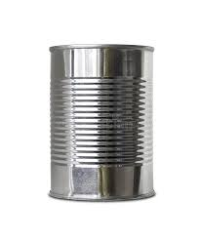
What is in this can?
What is metadata?
Slide courtesy of The DDI Training Working Group, “Introduction to Metadata for Research Data management: The DDI Perspective,” presented on April 29, 2021

Slide 6
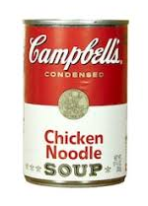
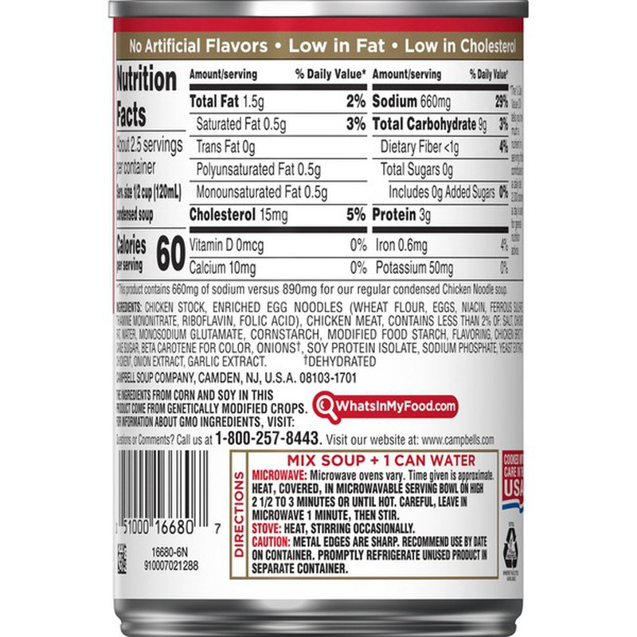
Now you know!
What is metadata?
Slide courtesy of The DDI Training Working Group, “Introduction to Metadata for Research Data management: The DDI Perspective,” presented on April 29, 2021

Slide 7
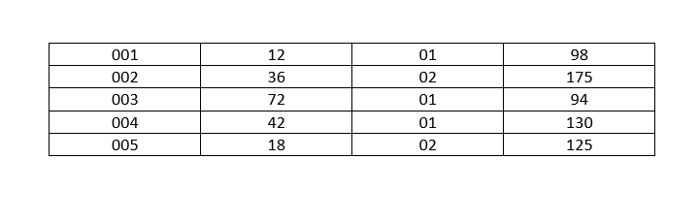
What do the numbers in this table mean?
What is metadata?
Slide courtesy of The DDI Training Working Group, “Introduction to Metadata for Research Data management: The DDI Perspective,” presented on April 29, 2021

Slide 8
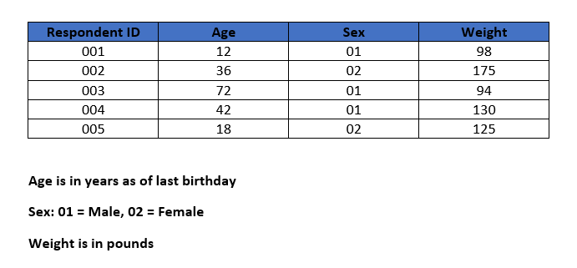
Metadata tells us!
What is metadata?
Metadata
Slide courtesy of The DDI Training Working Group, “Introduction to Metadata for Research Data management: The DDI Perspective,” presented on April 29, 2021

Slide 9
What Does “Meta” Mean, Anyway?
What is metadata?
Metadata are descriptions or information about some thing(s)
Greek: μετά- is a prefix meaning
    Beyond
    After
    Transcending
Literally – metadata are beyond the thing(s) being described
Slide courtesy of The DDI Training Working Group, “Introduction to Metadata for Research Data management: The DDI Perspective,” presented on April 29, 2021

Slide 10
Metadata Clarification
What is metadata?
The numeric table –
  Metadata are
    Headings for the columns
    Descriptions of the values in each column
  They describe the table and the data in the cells
People define it as “data about data”, but…
The food can –
  Metadata are what is written in the label on the can
  They describe the contents of the can
Let’s look at this in more detail …
Slide courtesy of The DDI Training Working Group, “Introduction to Metadata for Research Data management: The DDI Perspective,” presented on April 29, 2021

Slide 11
Metadata versus Data
What is metadata?
Consider microdata or administrative data
  Microdata –
    data collected from respondents in a statistical survey
    collected data are a description of each respondent
  Administrative data –
    data acquired as a result of managing some social program
    managed data are a description of each program participant
Why aren’t these metadata?
  In each case, data describe some things, but…
    Survey responses are used to measure characteristics of a population
    Administrative data are used to measure characteristics of the program participants
Slide courtesy of The DDI Training Working Group, “Introduction to Metadata for Research Data management: The DDI Perspective,” presented on April 29, 2021

Slide 12
Metadata – A Role
What is metadata?
Metadata is a role for data
No data are always metadata
  Data are metadata when they are used that way
Most (if not all) data can be used as metadata
Sometimes, data could be both metadata and data
  Depends on usage
  Same data, different perspective
Slide courtesy of The DDI Training Working Group, “Introduction to Metadata for Research Data management: The DDI Perspective,” presented on April 29, 2021

Slide 13
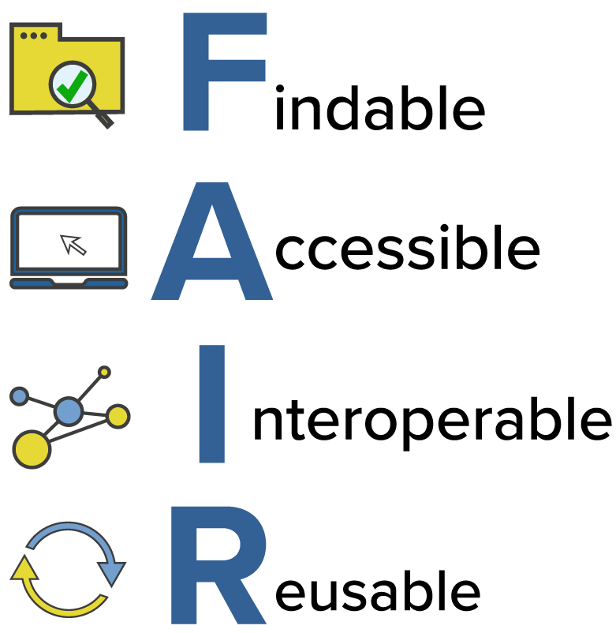
Why metadata?
The importance of FAIR data
Findable
Accessible
Interoperable
Reusable
Image courtesy of the National Institutes of Health, “Common Data Elements: Standardizing Data Collection” Online Training, accessed May 30, 2023

Slide 14
Why metadata?
The importance of FAIR data
Findable: For data to be findable there must be sufficient metadata; there must be a unique and persistent identifier; and the data must be registered or indexed in a searchable resource.
  Using Subject Headings like the Library of Congress Subject Headings (LCSH), Medical Subject Headings (MeSH)
Accessible
Interoperable
Reusable
Image courtesy of the National Institutes of Health, “Common Data Elements: Standardizing Data Collection” Online Training, accessed May 30, 2023

Slide 15
Why metadata?
The importance of FAIR data
Findable
Accessible: To be accessible, metadata and data should be readable by humans and by machines, and it must reside in a trusted repository.
  Inter-university Consortium for Political Science Research (ICPSR), Dataverse, GitHub (?)
Interoperable
Reusable
Image courtesy of the National Institutes of Health, “Common Data Elements: Standardizing Data Collection” Online Training, accessed May 30, 2023

Slide 16
Why metadata?
The importance of FAIR data
Findable
Accessible
Interoperable: Data must share a common structure, and metadata must use recognized, formal terminologies for description.
  measure_info.json
  Metadata schemas such as Data Documentation Initiative (DDI), Dublin Core (DC), Metadata Object Description Schema (MODS)
Reusable
Image courtesy of the National Institutes of Health, “Common Data Elements: Standardizing Data Collection” Online Training, accessed May 30, 2023

Slide 17
Why metadata?
The importance of FAIR data
Findable
Accessible
Interoperable
Reusable: Data and collections must have clear usage licenses and clear provenance and meet relevant community standards for the domain.
  Clearly stating the permissions of use and reuse, where the data comes from
Image courtesy of the National Institutes of Health, “Common Data Elements: Standardizing Data Collection” Online Training, accessed May 30, 2023

Slide 18
Metadata in action
The SDAD Data Commons project
Why is metadata necessary for the Data Commons project?
  Being an academic research project aside…
  There is an external need (stakeholders, data users)
  There is an internal need (interoperable systems)
How are we implementing metadata best-practices?
  On the dashboard
  In the data repositories
  Metadata website

Slide 19
Metadata in action
Important things for DSPGers to consider
As much as possible, try to implement best-practices within your team
  When sharing data internally, empathize with an outside user of the data. What information would they need to accurately find, access, use, and reuse the data?
You have implicit knowledge of data
  How will you codify implicit knowledge?
At the end of the summer, you will have a research product
  What are the standards we hold research products to?
  What can you do today to make your future you’s life easier?

